Slide 1
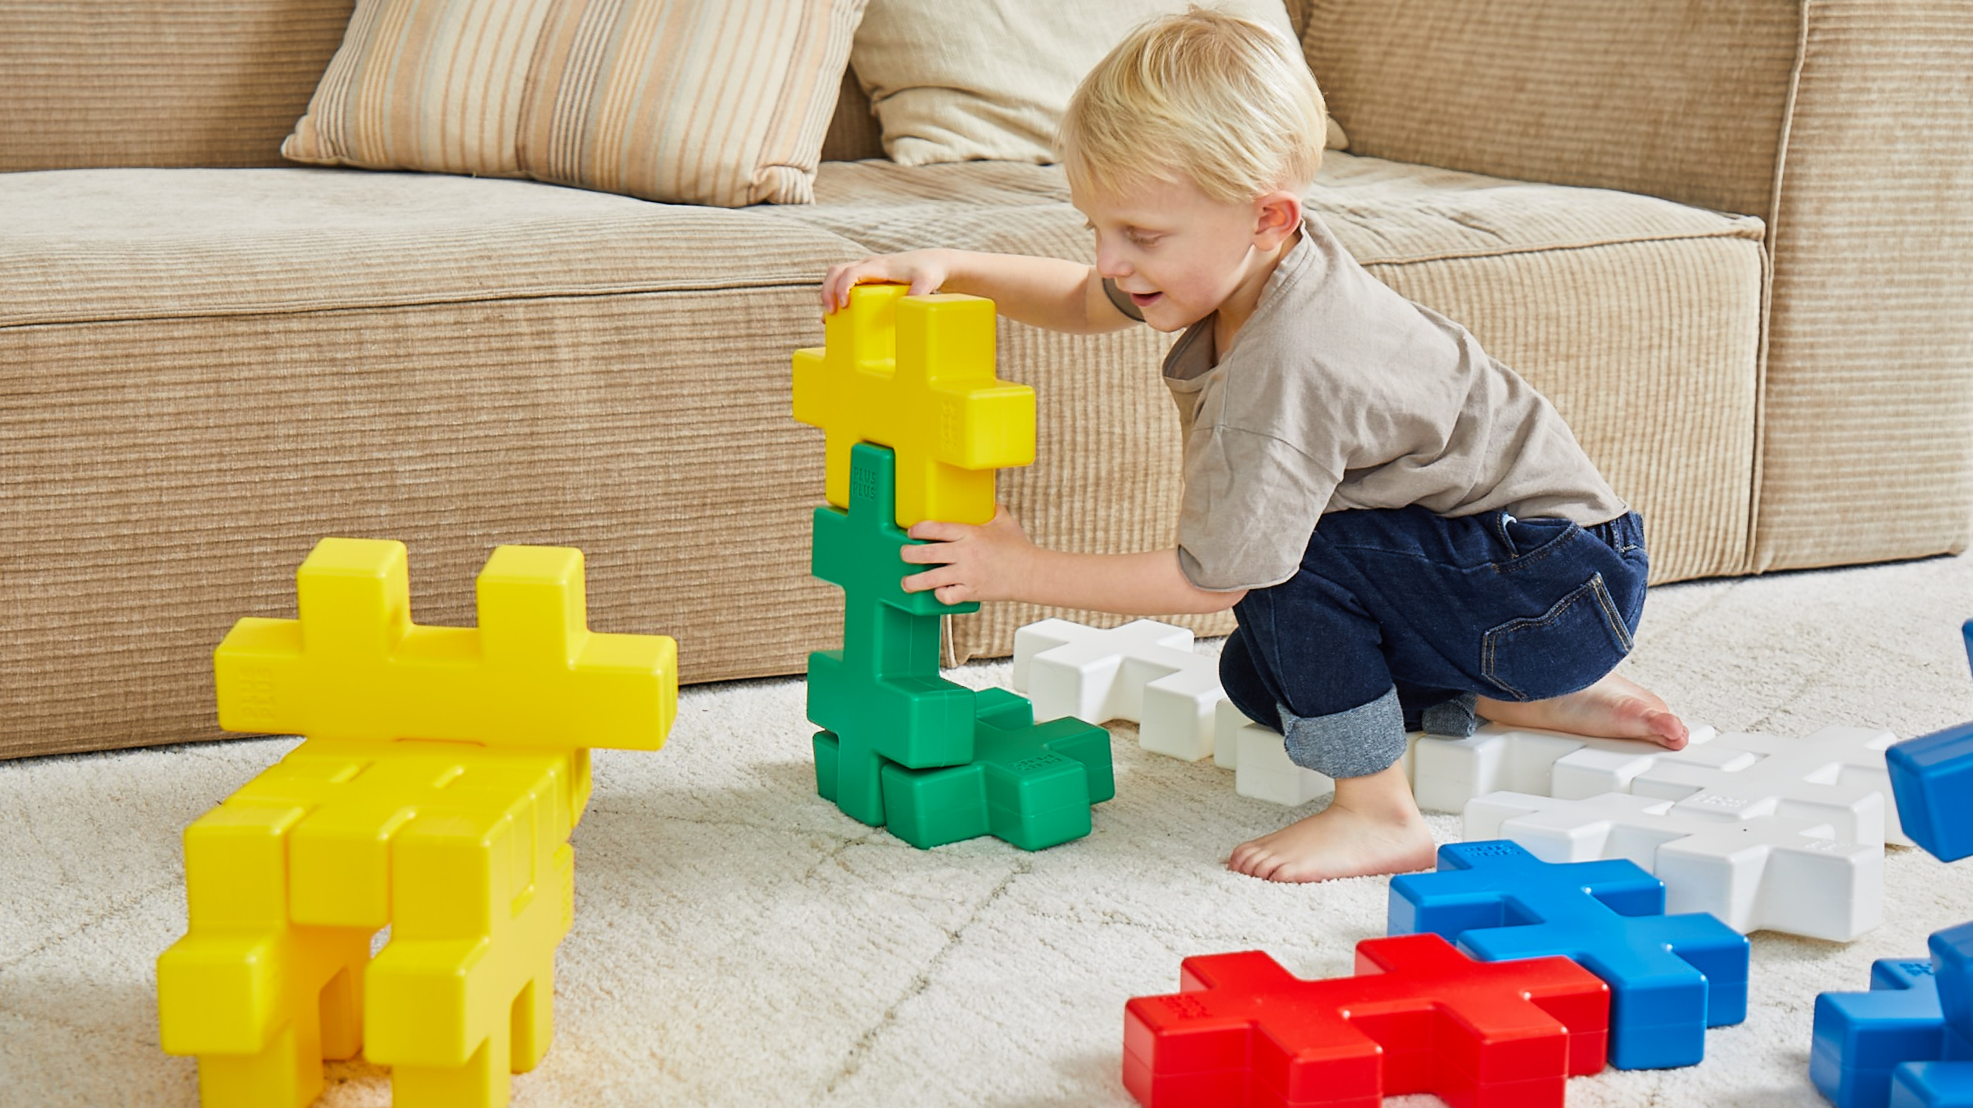

KÆMPE

Slide 2
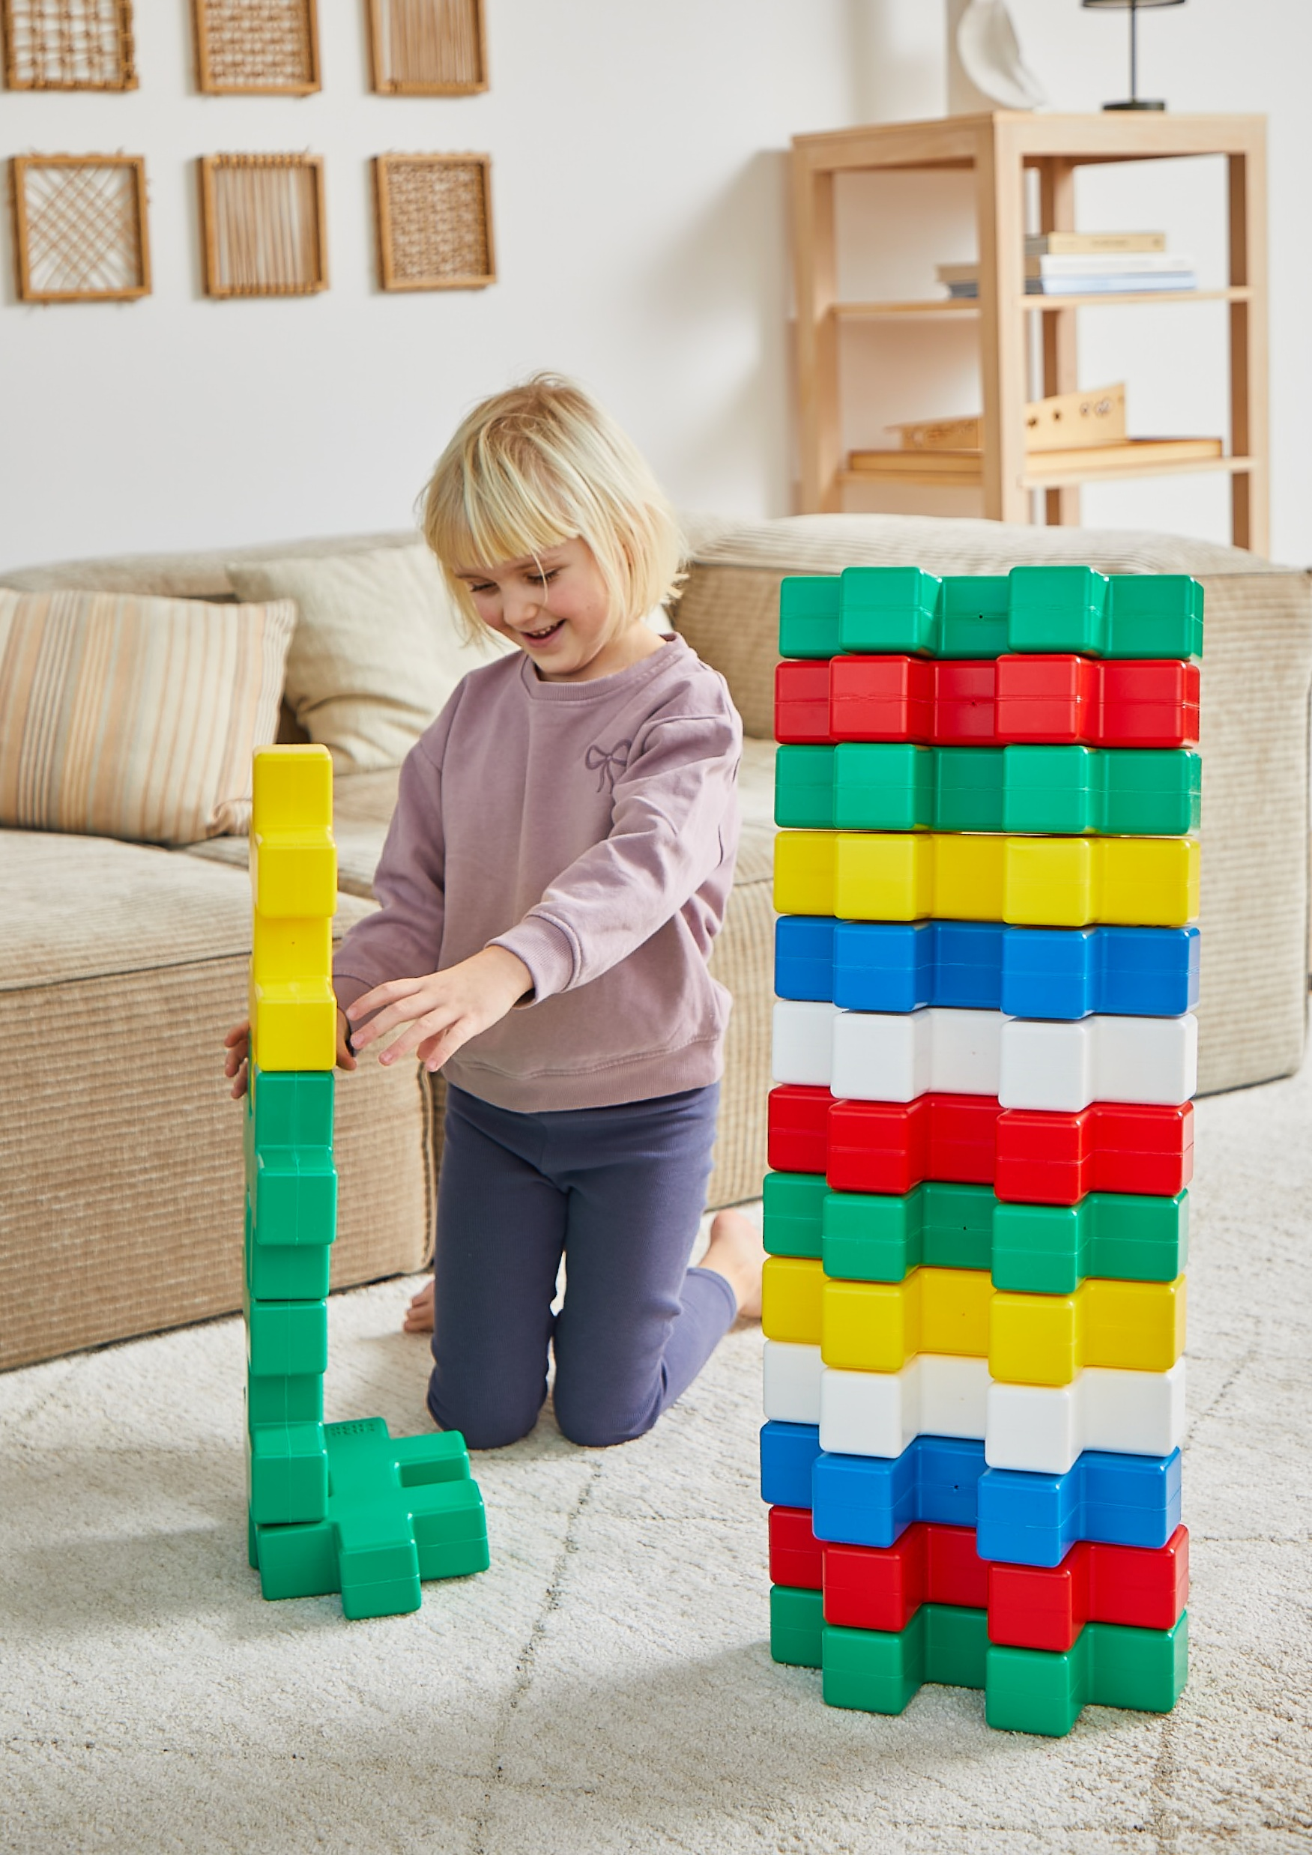
Discover KÆMPE – The Plus-Plus Experience, Super-Sized!
One shape, a whole new size!
KÆMPE takes creativity and play to an entirely new level. Whether indoors or outdoors, these oversized Plus-Plus pieces offer endless fun, development, and open-ended play for every stage of childhood.

Slide 3
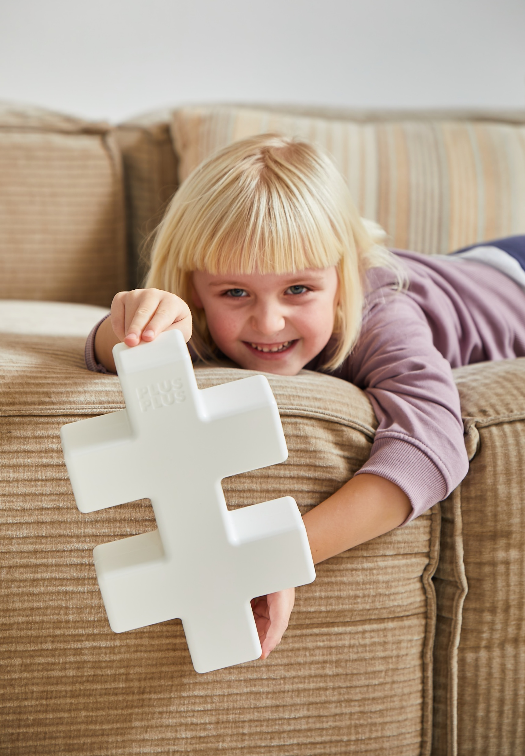
KÆMPE [KEM-peh], the Danish word for “giant”, is the perfect name for the largest innovation in the Plus-Plus universe. With the same iconic shape in a whole new scale, KÆMPE brings creativity, play, and learning to new heights.
Each piece measures an impressive 29 cm in length and 17.4 cm in width, making it ideal for small hands and big ideas.
Designed for children aged 2 and up, KÆMPE is perfect for both indoor and outdoor use—in homes, schools, kindergartens, libraries, public spaces, and anywhere creativity is welcome.

Slide 4
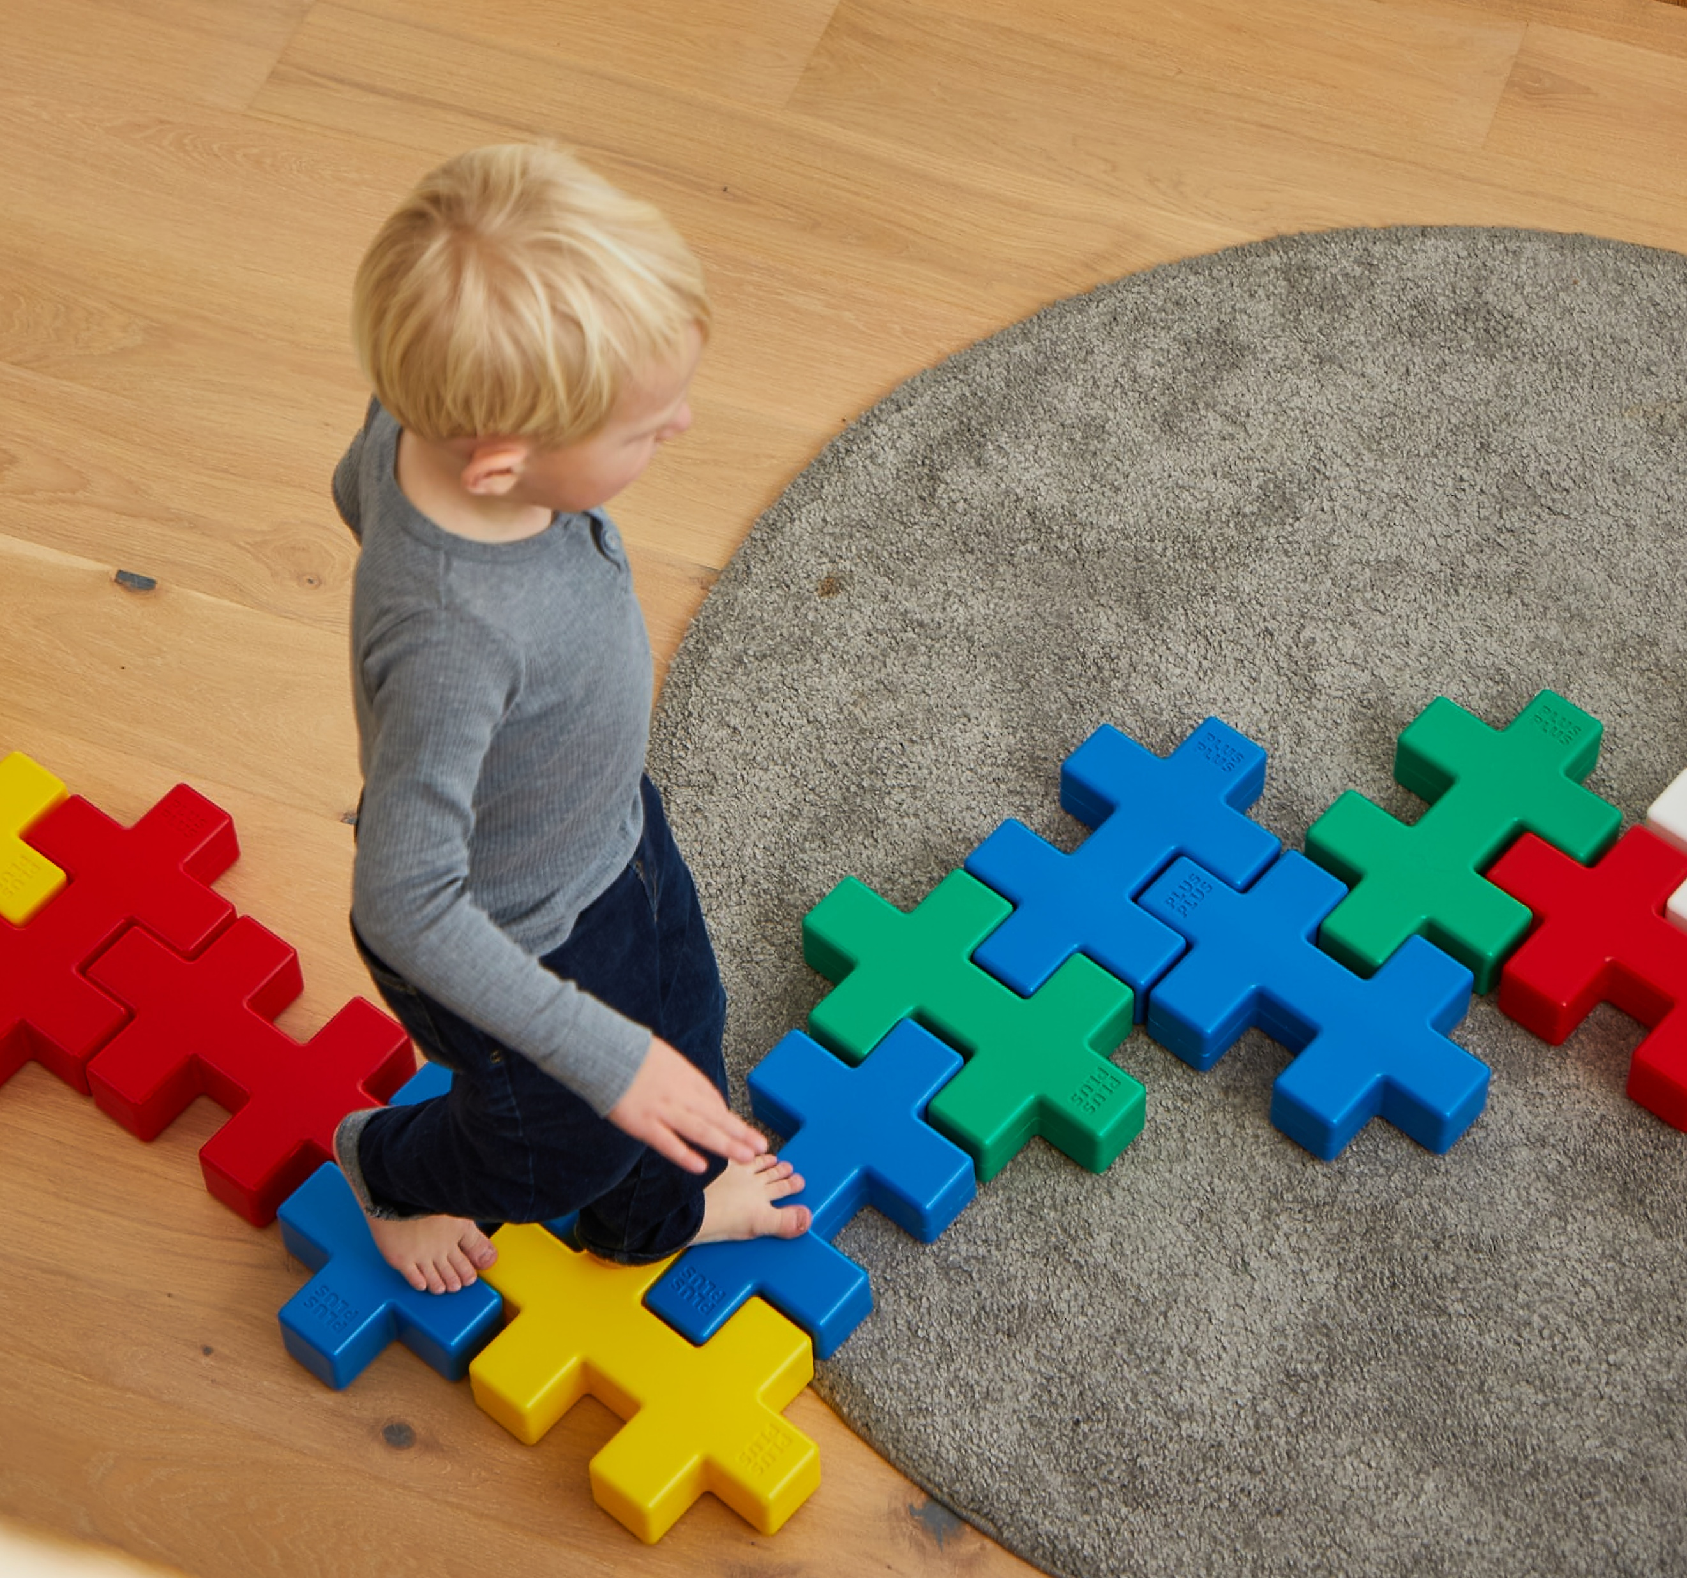
Same genius shape – just bigger
KÆMPE uses the exact same unique interlocking shape as every Plus-Plus piece. That means anything you can build with regular Plus-Plus, you can also build with KÆMPE—only bigger.
From flat mosaics to complex 3D creations, the creative possibilities remain endless.

Slide 5
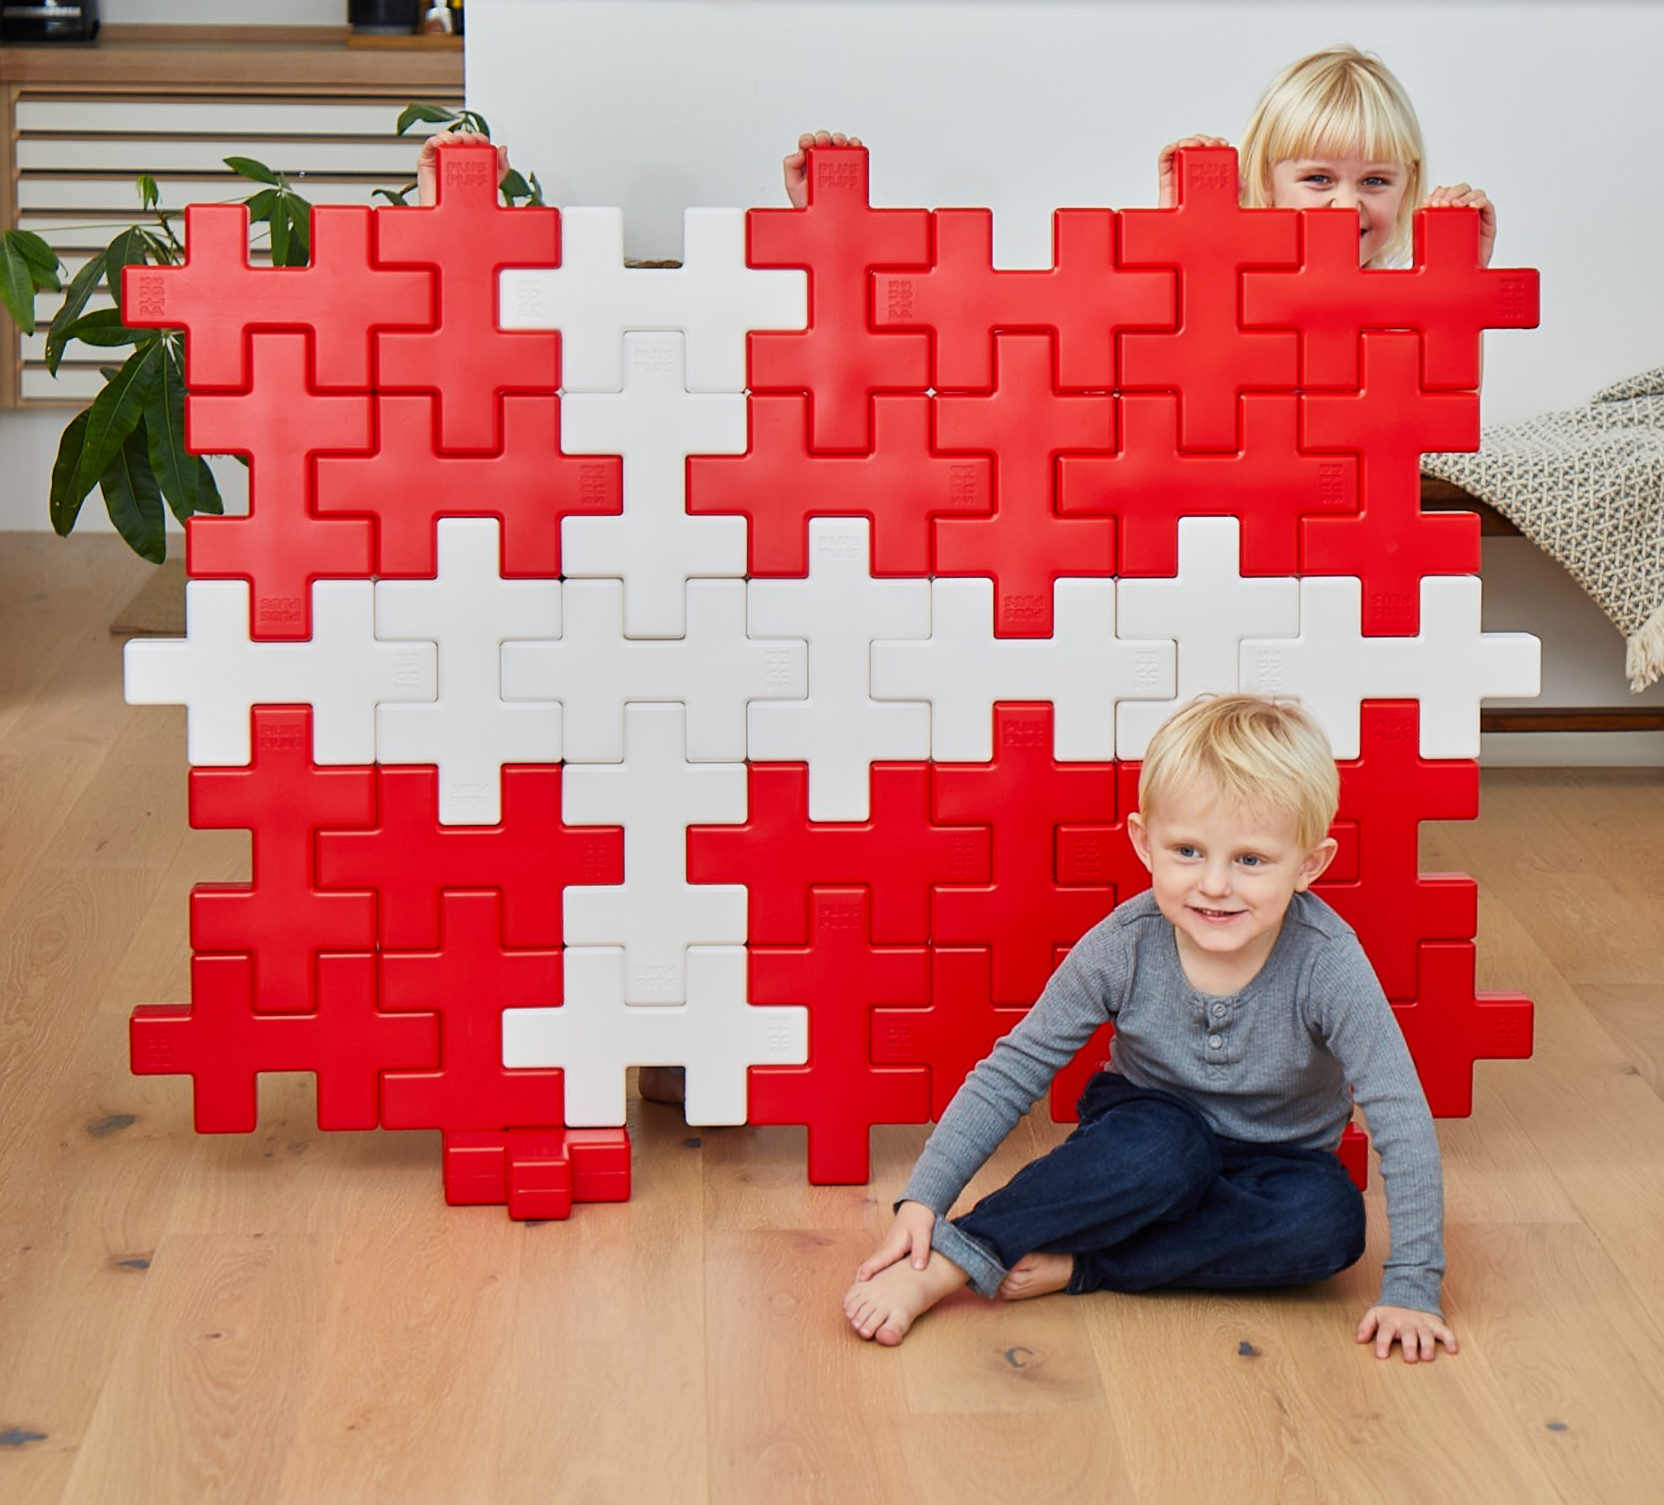
Why choose KÆMPE?
Encourages Development: Promotes motor skills, visual-spatial intelligence, cooperation, and imaginative thinking.
Build in 2D or 3D: Create everything from simple shapes to large-scale structures.
Lightweight yet Strong: Made from high-quality PE plastic—easy for children to handle and strong enough to sit or climb on.
Safe and Sustainable: Proudly made in Denmark using 100% wind power. Free from BPA, PVC, and phthalates.
Versatile for Any Space: Suitable for homes, educational environments, playrooms, and public installations.

Slide 6
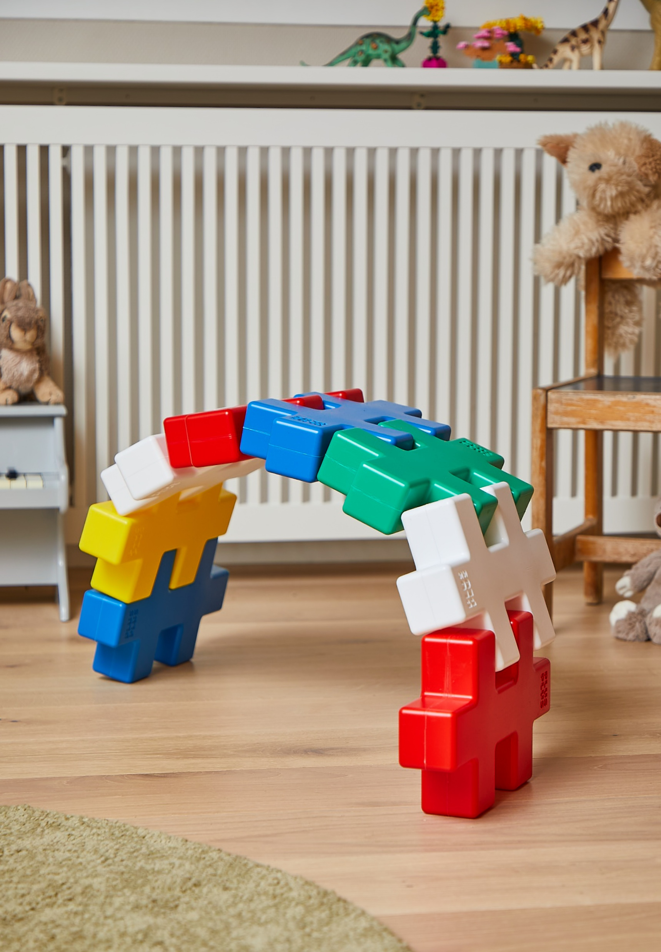
KÆMPE is more than a toy—it’s an educational tool, a creative outlet, and even a playful piece of furniture. Children love building towers, animals, vehicles, and entire imaginary worlds with these colorful oversized pieces.
Invite kids to step into a world of their own making—where the only limit is the size of their imagination.

Slide 7
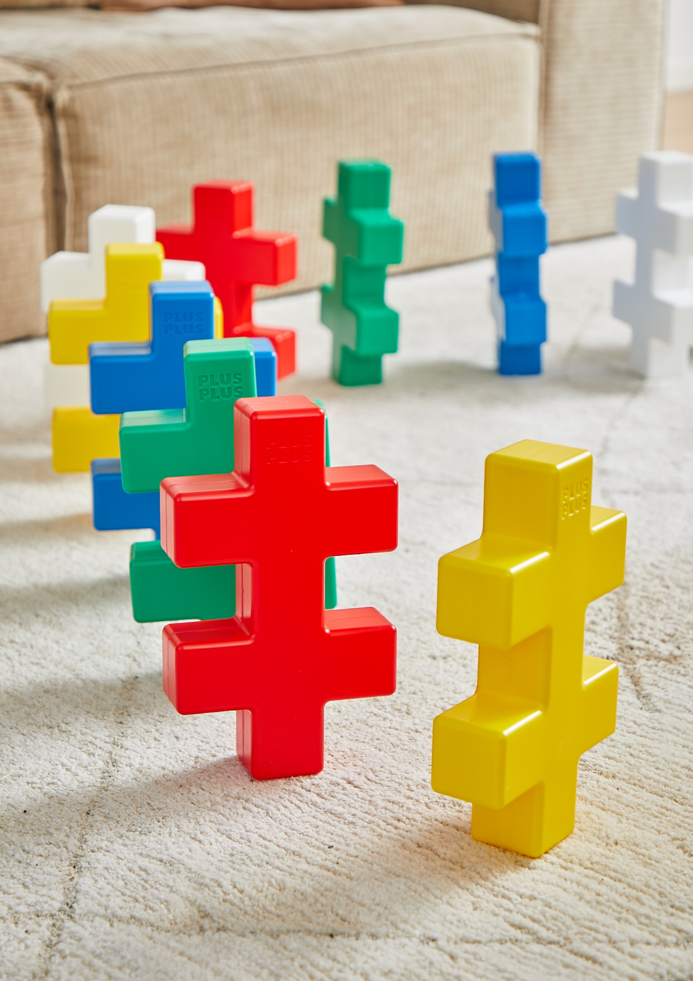
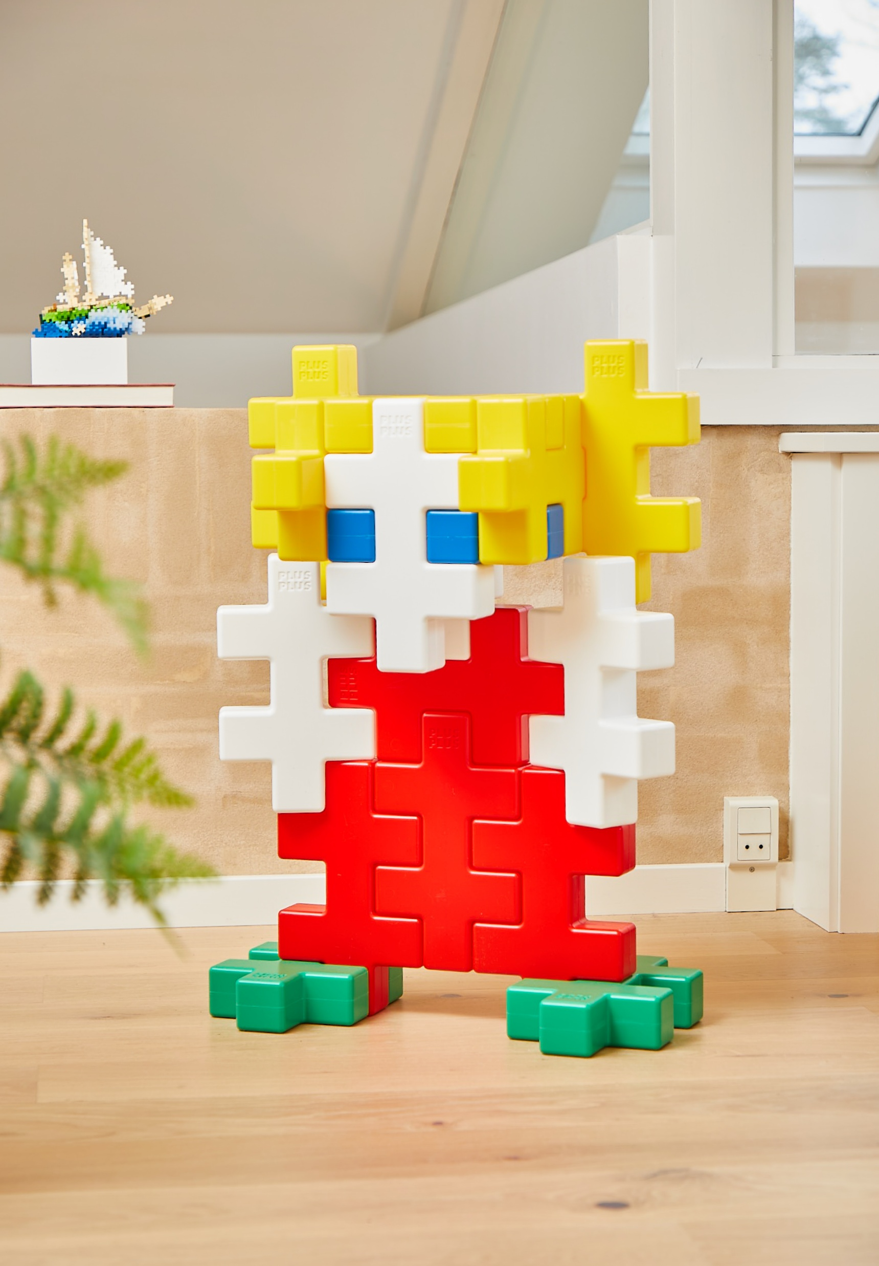
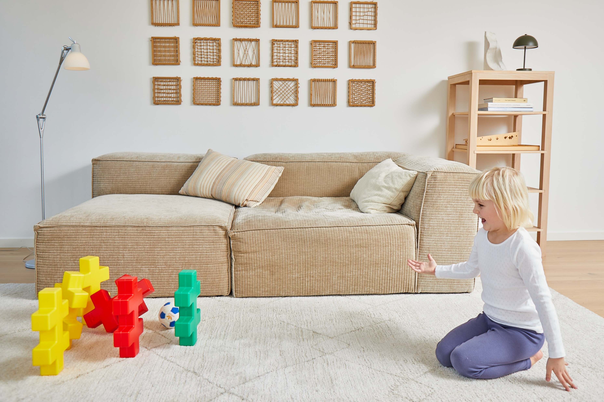
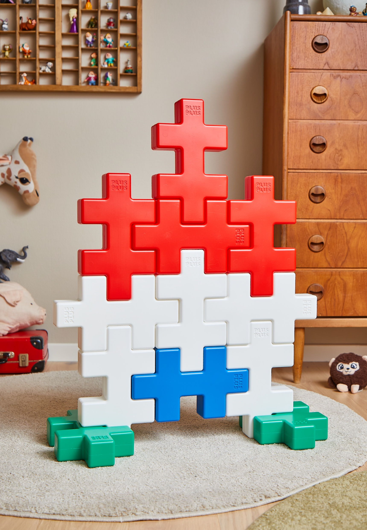
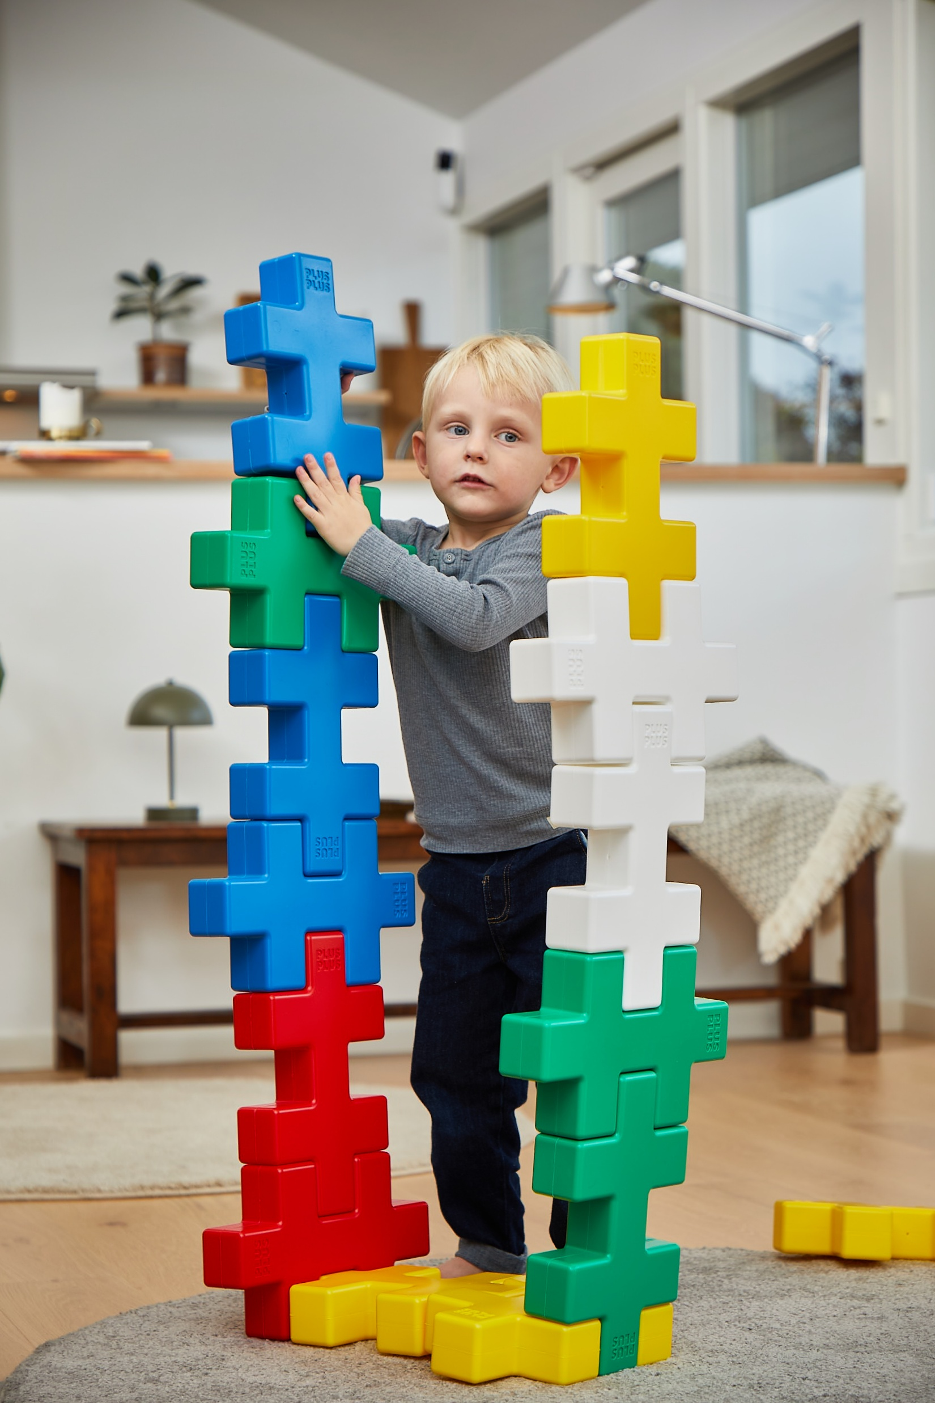
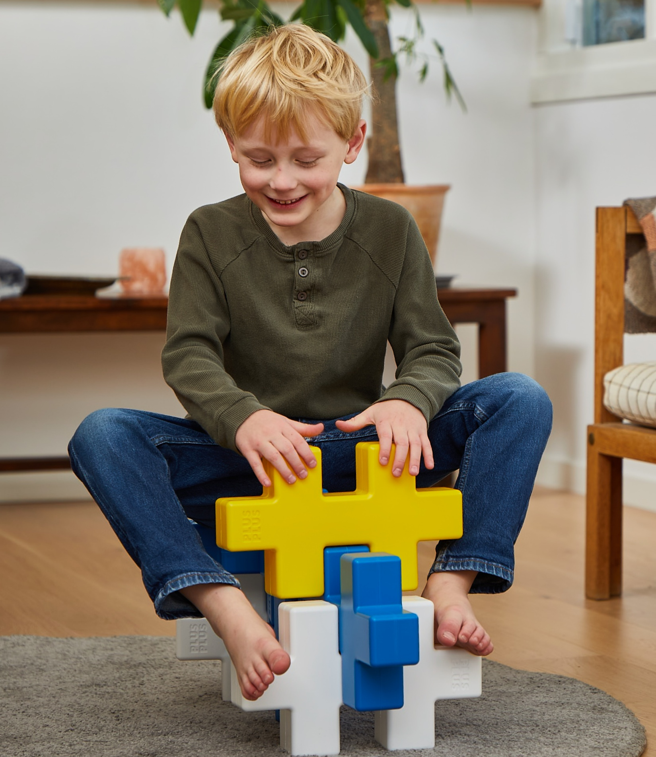

Slide 8

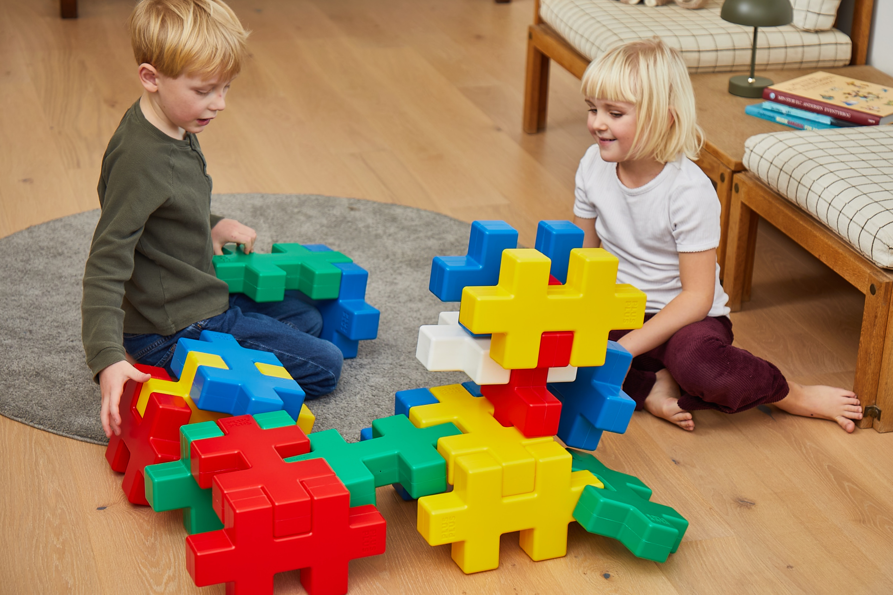
PLUS-PLUS KÆMPE 24 pcs – Educational
ITEM # 4410
Explore learning at a bigger scale with Plus-Plus KÆMPE!
KÆMPE introduces the iconic Plus-Plus shape in a giant format designed to support creative learning, physical engagement, and collaborative play in educational environments—both indoors and outdoors. The large, easy-to-handle pieces (29 cm x 17.4 cm) help develop fine and gross motor skills, spatial understanding, and problem-solving through active, hands-on exploration.
Lightweight yet highly durable, KÆMPE is made from high-quality PE and produced in Denmark using 100% wind power, making it a safe and sustainable choice for schools and institutions.
Each pack contains 24 giant KÆMPE pieces – 5 of each color (yellow, green, red, blue) and 4 white, packed in a sturdy carton box suitable for educational use.
Encourage collaboration, creativity, and learning through play with KÆMPE.
KÆMPE [KEM-peh] means “giant” in Danish—reflecting both the size and the educational potential of this Plus-Plus set.
Ages: 2+

Slide 9
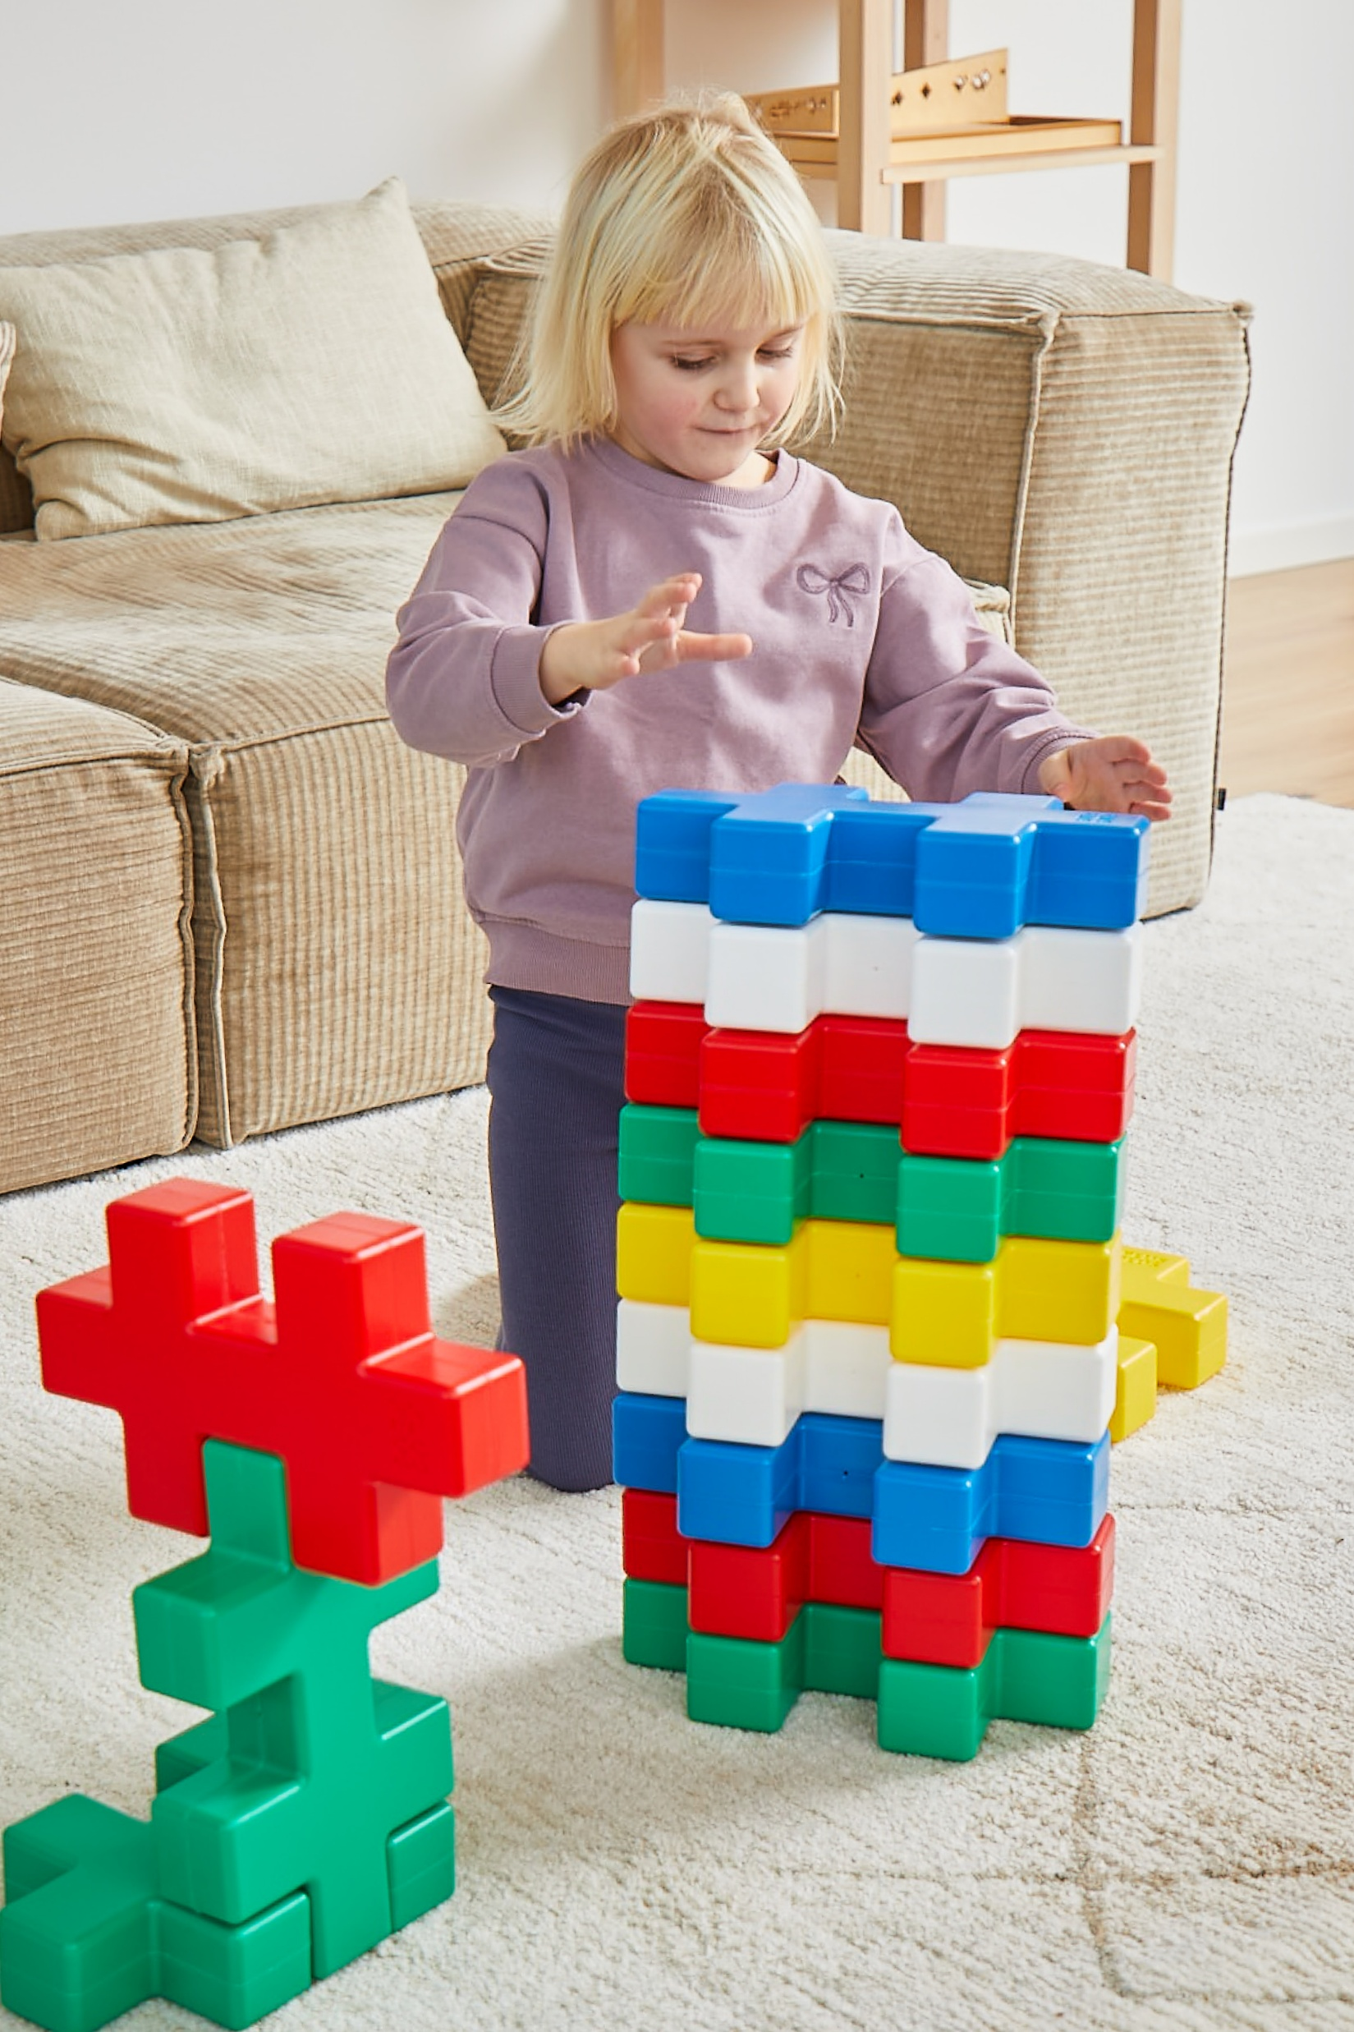
PLUS-PLUS KÆMPE 24 pcs – Educational
ITEM # 4410
Ages: 2+
Contents : 24 pcs (5 x red, 5 x blue, 5 x green, 5 x yellow, 4 x white)
Carton : 35 x 40 x H 42 cm
Cartons per pallet: 30
Height of pallet : 225 cm
Each single-piece measures: 29 x 17.4 x 5.8 cm
EAN: 5710409113120
Instruction Leaflet in design stage

